Slide 1

INTRODUCTION TO CYBERSECURITY
CYBERSECURITY

Slide 2
SYLLABUS
Introduction to cyber security.
Why do we need cyber security.
What is cyber security.
The cia traid.
Vulnerability, threat and risk.

Slide 3
SYLLABUS
2. HISTORY OF cyber security.
STORY OF CYBER SECURITY.
3. COMPONENTS OF CYBERSECURITY.
PACKET STRUCTURE.
ADDRESSING.
NETWORK ARCHITECTURE.
FIREWALLS

Slide 4
SYLLABUS
4. CYBER SECURITY FRAMEWORKS.
TYPES OF CYBERSECURITY FRAMEWORKS.
5. FUNDAMENTALS OF NETWORKING.
Network Architecture
NETWORKING TOOLS

Slide 5
SYLLABUS
6. Nmap (Network mapper)
About Nmap.
Installation.
Types of scans using Nmap.
7. Cyber security and ethical hacking.
About ethical hacking.
Ethical hacking using kali linux.

Slide 6
SYLLABUS
8. Introduction to cryptography.
What is cryptography.
Classification of cryptography.
Working on cryptographic algorithm.
9. Symmetric and asymmetric cryptography.

Slide 7
SYLLABUS
10. RSA (Rivest–Shamir–Adleman).
RSA Cryptography hands on Hashing And Algorithm's
11. Introduction to steganography.
What is steganography.
Basic steganography.

Slide 8
SYLLABUS
12. Lsb (Least significant bit )
Lsb steganography hands on stegnanography tools.
13. DDOS
What is dos and ddos attack.
How does it work.
Types of ddos attack.
Dos attack demonstration.

Slide 9
SYLLABUS
14. Phishing
hands on phishing.
15. Future and carrier opportunities.
Why should you learn cyber security.
How to become a cyber security engineer.
Interview questions.

Slide 10

Why do we need cyber security
Cryptography protects the confidentiality of information
It ensures the integrity of your data
It assures that the sender or receiver is the right one
Both sender and receiver are held accountable through non-repudiation
Cryptography also ensures the availability of data
Uphold information security with powerful cryptography strategies

Slide 11

What is cyber security
Cyber security is the practice of protecting critical systems and sensitive information from digital attacks. Also known as information technology (IT) security.
cyber security measures are designed to combat threats against networked system and applications, whether those threats originate from inside or outside of an organization.

Slide 12
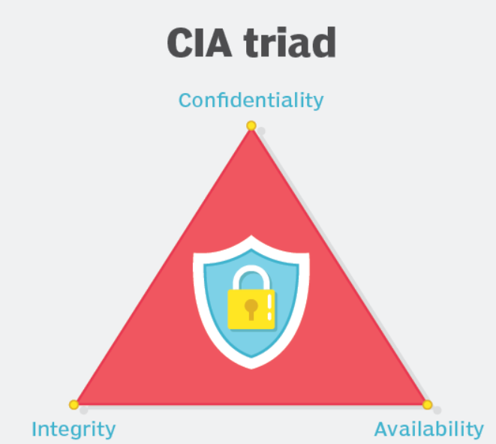
THE cia traid
Confidentiality, integrity and availability.
Confidentiality is roughly equivalent to Confidentiality measures are designed to prevent sensitive information from unauthorized access attempts.
Integrity involves maintaining the consistency, accuracy and trustworthiness of data over its entire lifecycle.
Availability means information should be consistently and readily accessible for authorized parties.

Slide 13

Vulnerability/weakness/bug/loopholes, Threat and Risk
Vulnerability refers to a weakness in your hardware, software, or procedures. It’s a gap through which a outsider can gain access to your assets. In other words, threats exploit vulnerabilities.

Slide 14
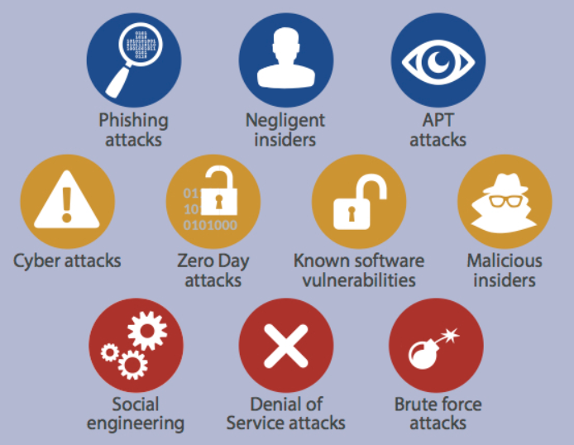
threats
Threats have the potential to steal or damage data, disrupt business, or create harm in general.

Slide 15




risk
risk is the intersection of assets, threats, and vulnerabilities. It’s the potential for loss, damage, or destruction of an asset when a threat takes advantage of a vulnerability. Put another way:
Threats + Vulnerability = Risk

Slide 16
INTRODUCTION TO CYBERSECURITY
Thank you

Slide 17
Scenario of cyber attack
welcome

Slide 18
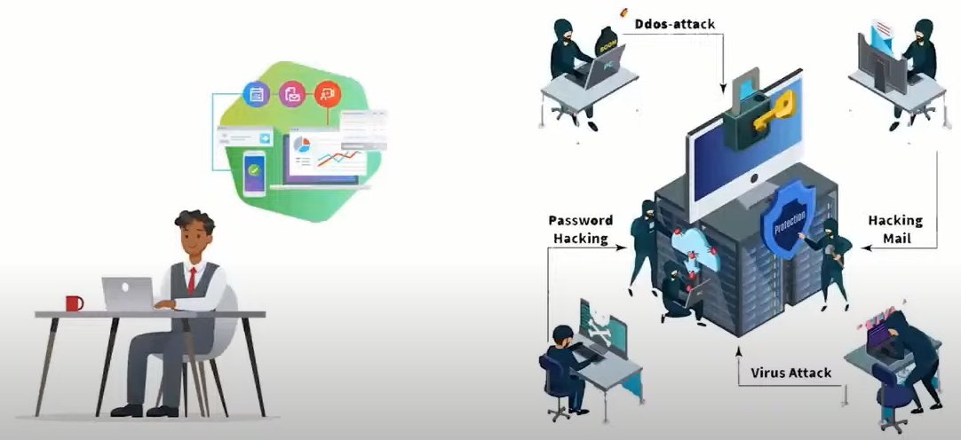
Meet john

Slide 19
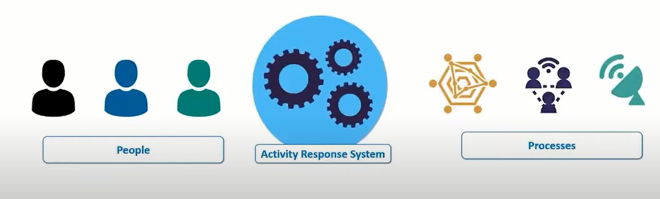
Activity response system

Slide 20
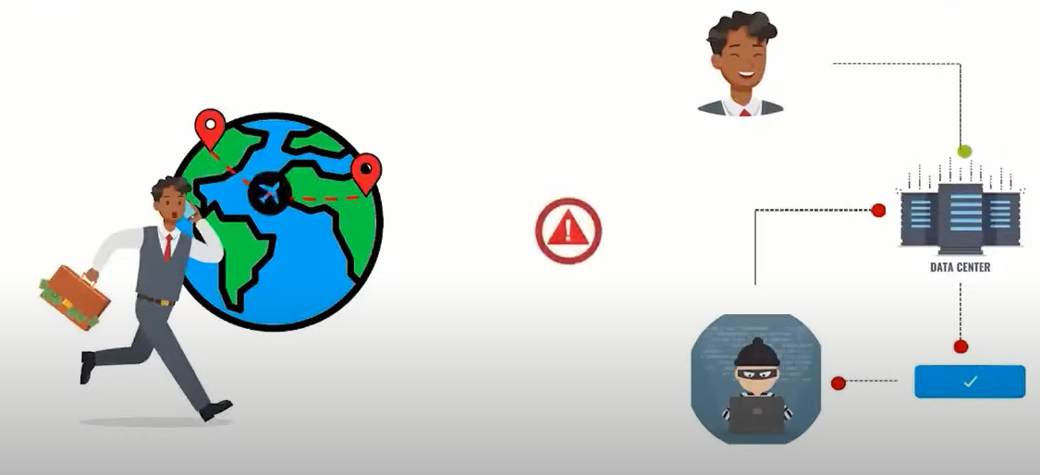
Cyber attack

Slide 21
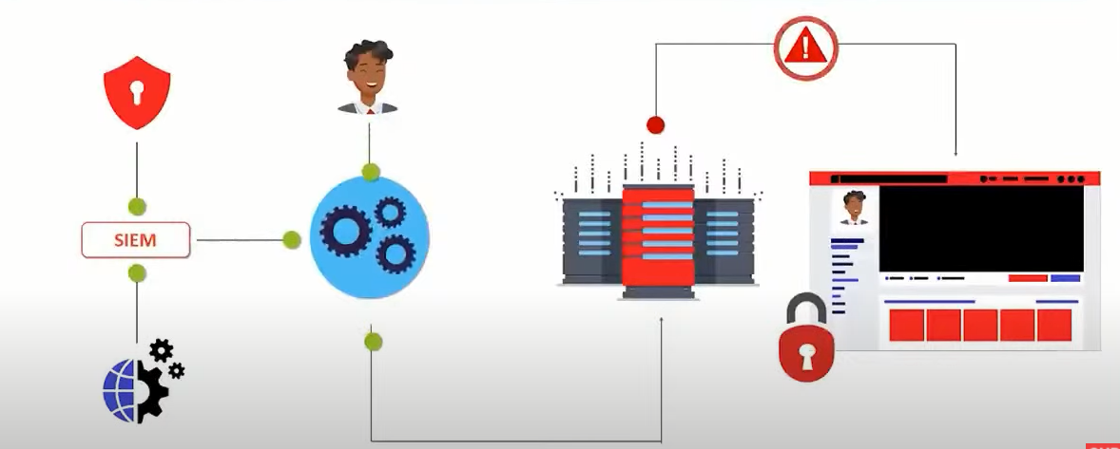
Security information and event management

Slide 22
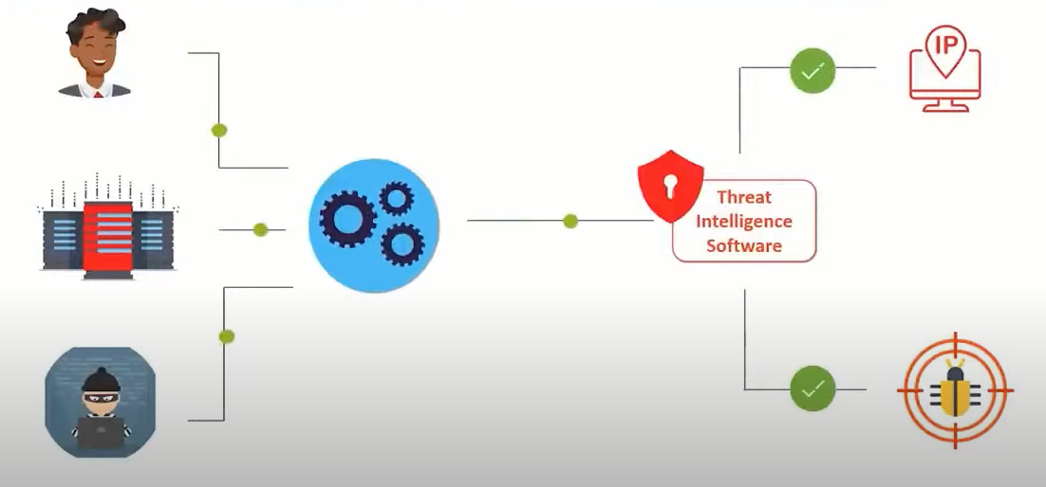
Threat intelligent software

Slide 23
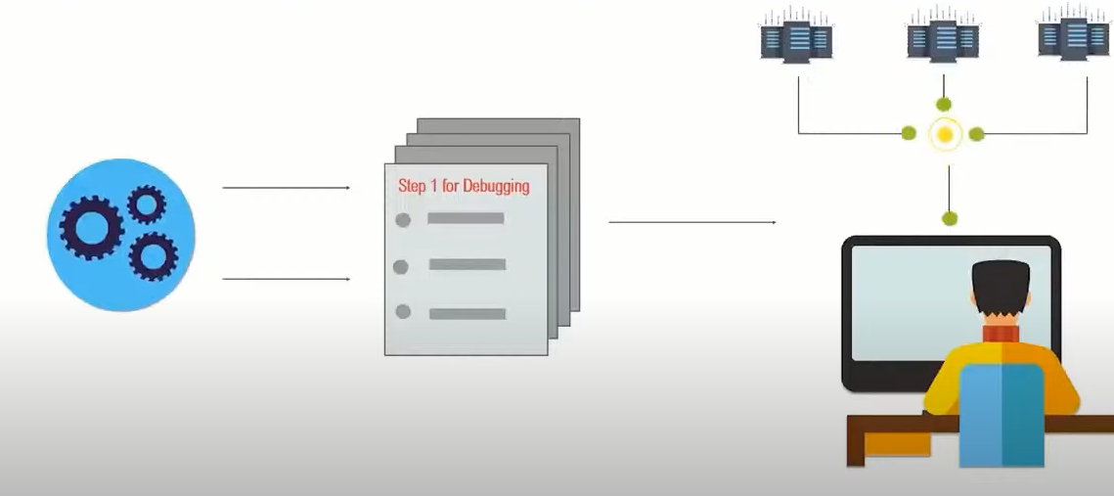
Patching and analysing

Slide 24
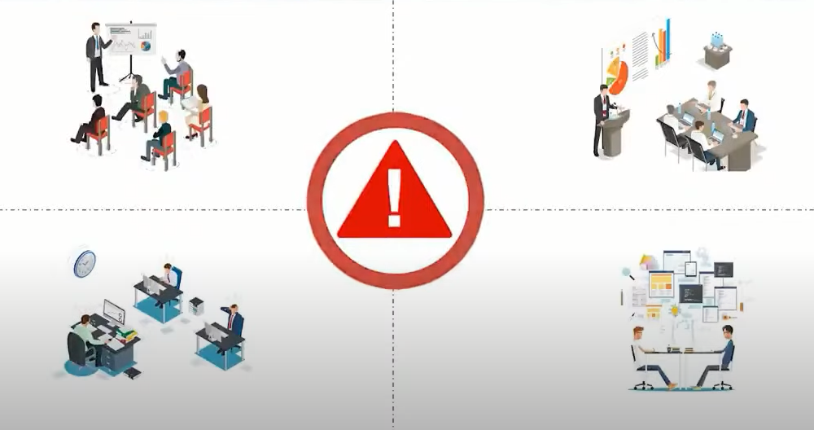
Without cyber security
Incident Response Platform:
Found the source of the attack
Fixed the vulnerability.
Notify all affected party.

Slide 25
Scenario of cyber attack
Thank you end

Slide 26
Cyber Security Tools
Welcome

Slide 27

Tools Of cyber security
Firewall's.
Antivirus.
PKI Service.
MDR Service.
Penetration Testing.
Staff training.

Slide 28

Tools Of cyber security
Firewall's:
firewall is the core of security tools.
Its job is to prevent unauthorized access to or from a private network.
The firewalls are used to prevent unauthorized internet users from accessing private networks connected to the Internet.
All messages are entering or leaving the intranet pass through the firewall.
The firewall examines each message and blocks those messages that do not meet the specified security criteria.

Slide 29
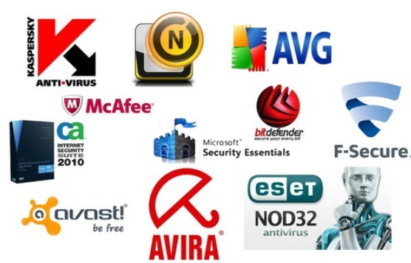
Tools Of cyber security
Antivirus Software:
Antivirus software is a program which is designed to prevent, detect, and remove viruses and other malware attacks on the individual computer, networks, and IT systems.
It also protects our computers and networks from the variety of threats and viruses such as Trojan horses, worms, key loggers, browser hijackers, rootkits, spyware, botnets, adware, and ransomware.

Slide 30
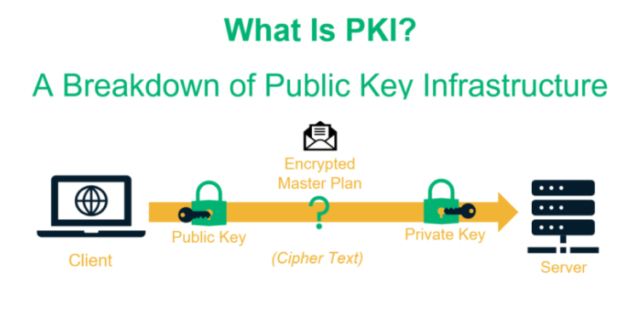
Tools Of cyber security
PKI Services: / Cryptography
PKI stands for Public Key Infrastructure.
This tool supports the distribution and identification of public encryption keys.
It enables users and computer systems to securely exchange data over the internet and verify the identity of the other party.

Slide 31
Tools Of cyber security
PKI can also be used to:
Enable Multi-Factor Authentication and access control
Create compliant, Trusted Digital Signatures.
Encrypt email communications and authenticate the sender's identity.
Digitally sign and protect the code.
Build identity and trust into IoT ecosystems.

Slide 32
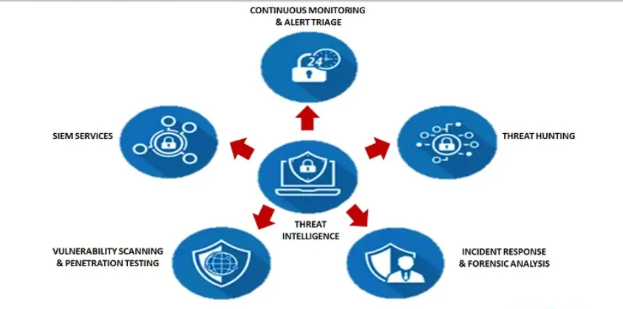
Tools Of cyber security
Managed Detection and Response Service (MDR):
Today's cybercriminals and hackers used more advanced techniques and software to breach organization security So, there is a necessity for every businesses to be used more powerful forms of defences of cybersecurity.
MDR is an advanced security service that provides threat hunting, threat intelligence, security monitoring, incident analysis, and incident response.

Slide 33
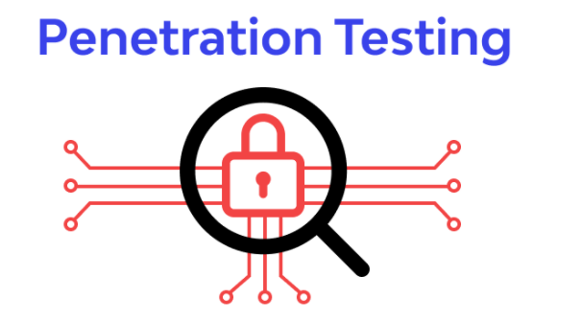
Tools Of cyber security
Penetration Testing:
Penetration testing, or pen-test, is an important way to evaluate our business's security systems and security of an IT infrastructure by safely trying to exploit vulnerabilities.
These vulnerabilities exist in operating systems, services and application, improper configurations or risky end-user behavior. In Penetration testing, cyber security professionals will use the same techniques and processes utilized by criminal hackers to check for potential threats and areas of weakness.

Slide 34
Cyber Security Tools
Thank you end

Slide 35
History of cyber security
Welcome start

Slide 36
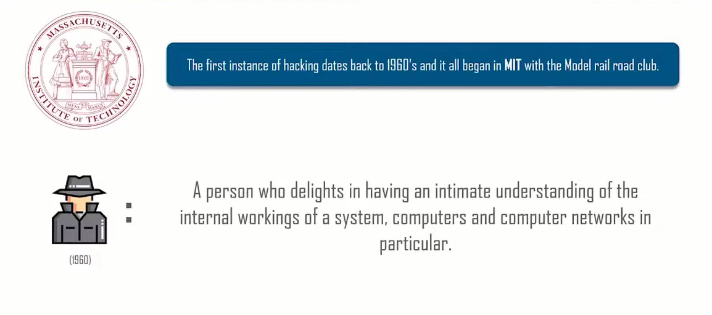
Early days of hacking

Slide 37
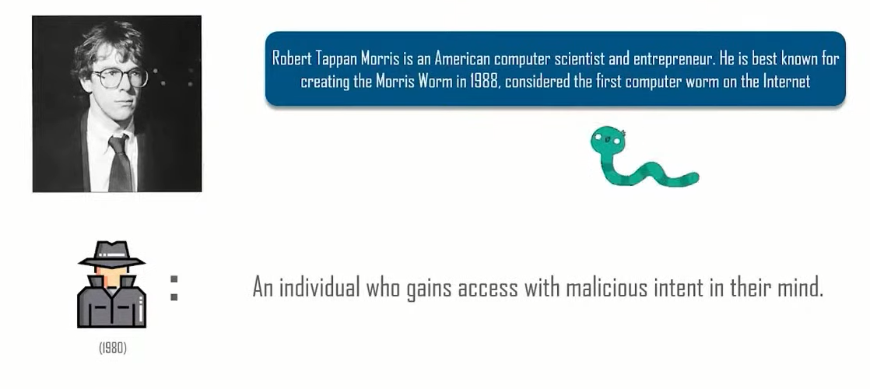
The first computer worm

Slide 38
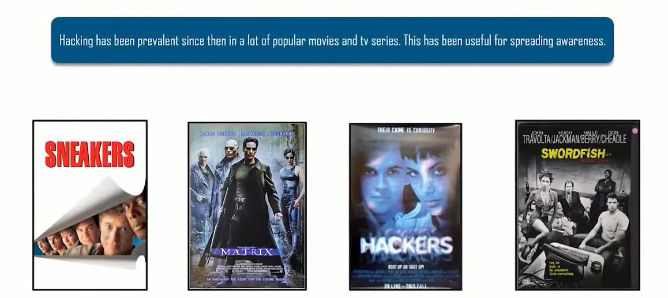
Hacking in popular culture

Slide 39
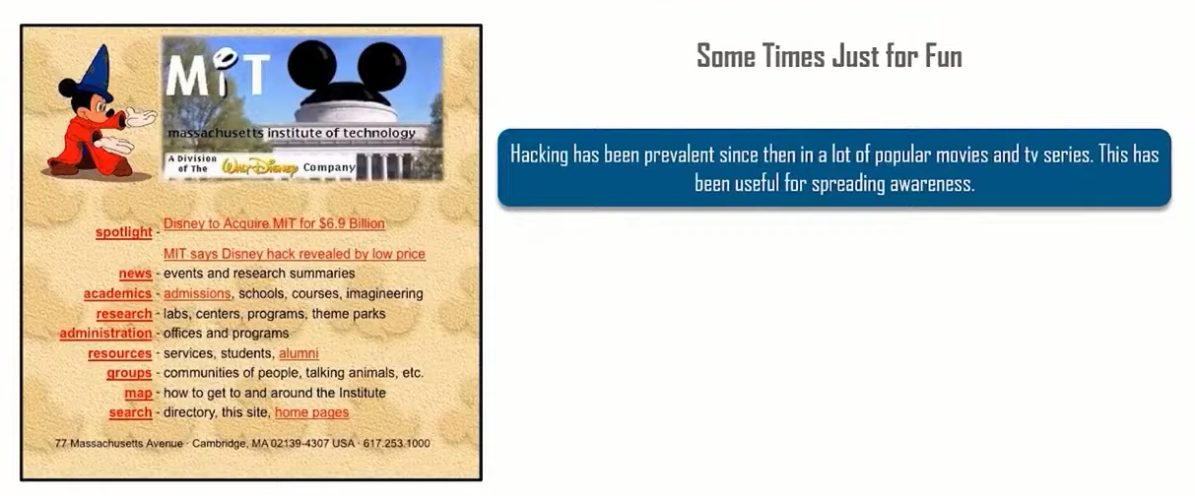
Why do people hack

Slide 40
Why do people hack
In 1967, IBM invited school kids to try out their new computer. After exploring the accessible parts of the system, the students worked to probe deeper, learning the system’s language, and gaining access to other parts of the system.
This was a valuable lesson to the company and they acknowledged their gratitude to “a number of high school students for their compulsion to bomb the system”, which resulted in the development of defensive measures – and possibly the defensive mindset that would prove essential to developers from then on. Ethical hacking is still practiced today.

Slide 41
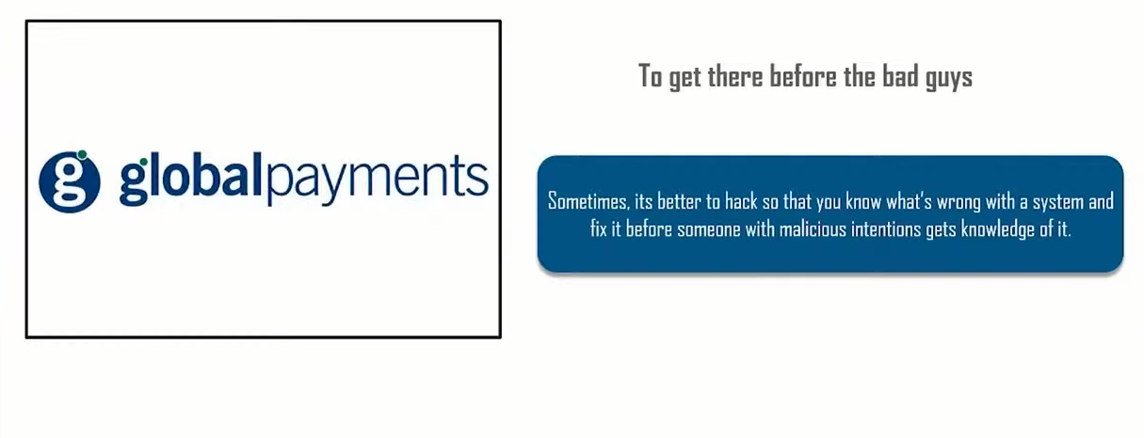
Why do people hack

Slide 42
History of cyber security
Thank you end

Slide 43
Types of hacker
Welcome

Slide 44
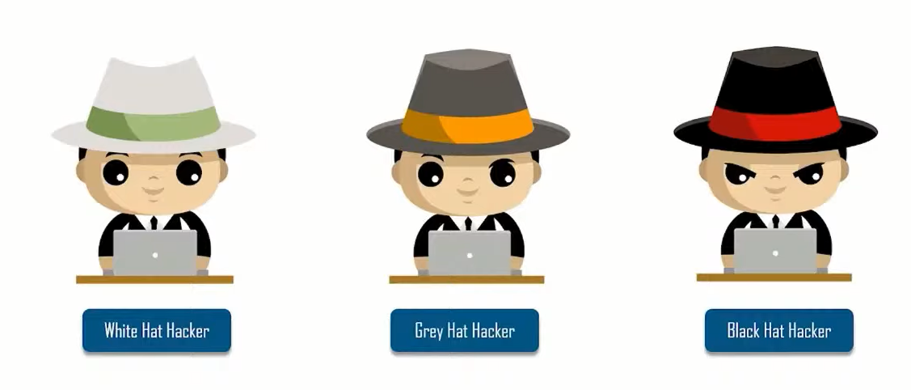
Types of hacker

Slide 45
White hat hacker
The Good Guy.
Enter the White Hat hacker, the good guy who uses his (or her) capabilities to damage your organization — but only hypothetically. Instead, the real purpose is to uncover security failings in your system in order to help you safeguard your business from the dangerous hackers.
Companies hire White Hats to stress test their information systems. They run deep scans of networks for malware, attempt to hack information systems using methods Black Hats would use, and even try to fool staff into clicking on links that lead to malware infestations.

Slide 46
Gray hat hacker
The Ugly
Somewhere between white and black lies the ugly — the Gray Hats. Some Gray Hat hackers like to believe they're doing something good for companies by hacking their websites and invading their networks without permission, but company owners rarely appreciate unauthorized forays into their business information infrastructure.
In most cases, a Gray Hat's real intention is to show off his skills and gain publicity — maybe even appreciation — for what he considers a contribution to cybersecurity.
Gray Hats often say they mean no harm with their incursions. Sometimes, they're simply curious about hacking a high-profile system — without regard to privacy and numerous other laws.

Slide 47

Black hat hacker
Black Hat hackers are criminals who break into computer networks with malicious intent. They may also release malware that destroys files, holds computers hostage, or steals passwords, credit card numbers, and other personal information.
Distributing malicious software isn't difficult, partly because hacking today operates like big business. Organizations boast partners, resellers, vendors, and associates, and they buy and sell licenses for malware to other criminal organizations for use in new regions or markets.

Slide 48
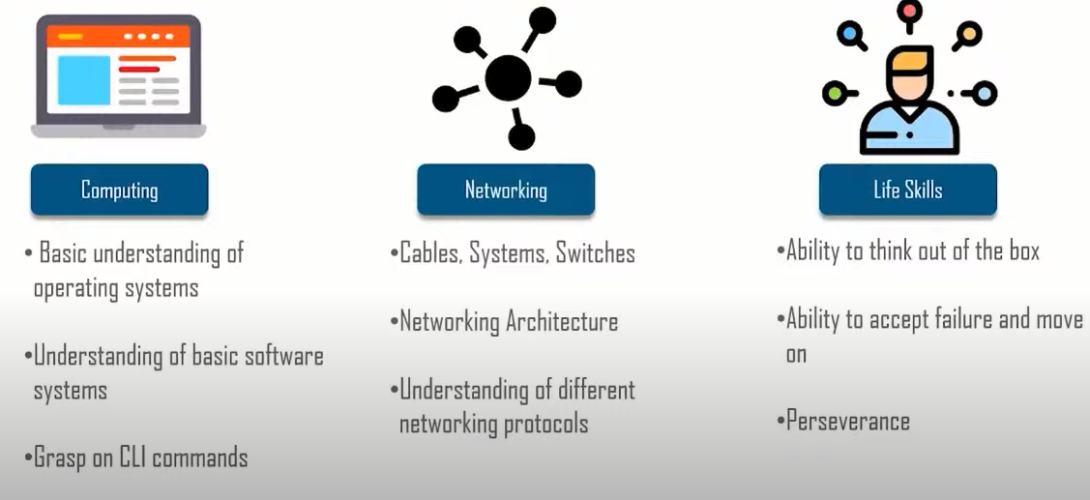
Skills necessary

Slide 49
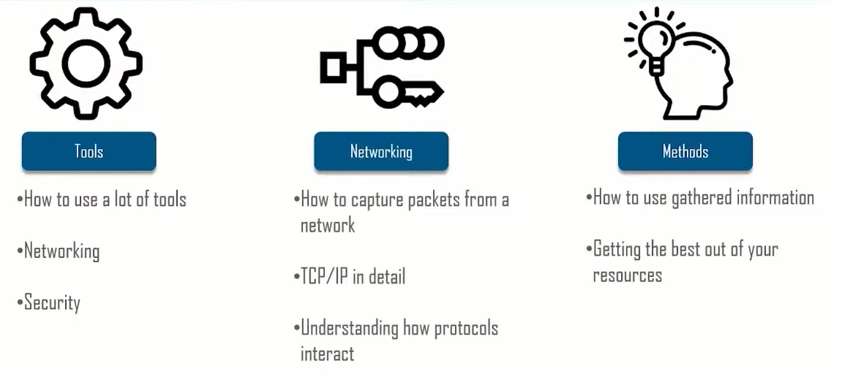
Skills necessary

Slide 50
Types of hacker
end

Slide 51
Types of attack
start

Slide 52
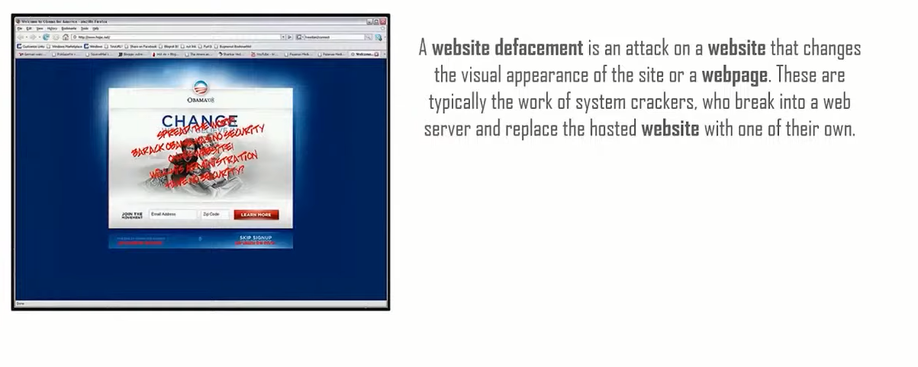
defacing

Slide 53
Denial of service
A Denial-of-Service (DoS) attack is an attack meant to shut down a machine or network, making it inaccessible to its intended users.
An additional type of DoS attack is the Distributed Denial Of Service Attack(DDOS) A DDoS attack occurs when multiple systems orchestrate a synchronized DoS attack to a single target. The essential difference is that instead of being attacked from one location, the target is attacked from many locations at once.
Some common examples of DDoS attacks are UDP flooding, SYN flooding and DNS amplification.

Slide 54
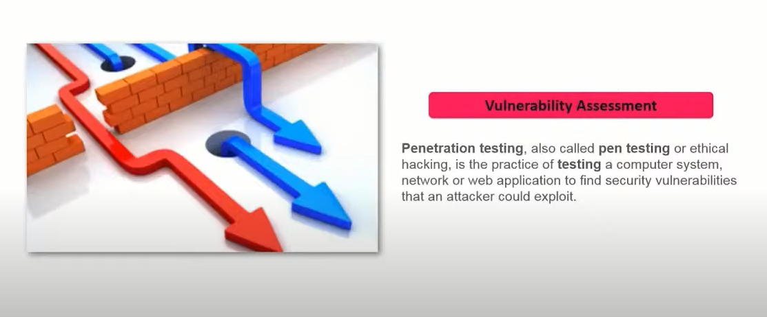
Penetration testing

Slide 55
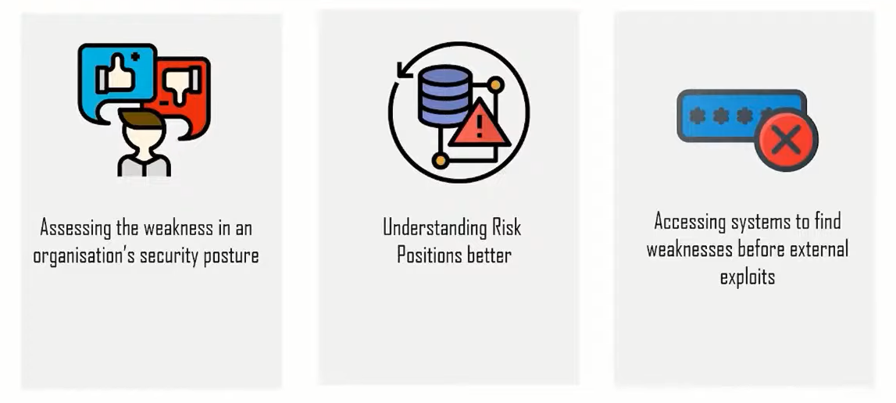
Goals of Penetration testing

Slide 56
Types of attack
end

Slide 57
FOOTPRINTING
wELCOME

Slide 58

WHAT IS FOOTPRING
Footprinting is the technique used for gathering information about computer systems and the entities they belong to. To get this information, a hacker might use various tools and technologies.

Slide 59
TYPES OF FOOTPRINTING
PASSIVE FOOTPRINTING
ACTIVE FOOTPRINTING
WHAT DO HACKERS GET IN FOOTPRINTING
NETWORK INFORMATION
SYSTEM INFORMATION
ORGNIZATIONAL INFORMATION
THREATS
SOCIAL ENGINEERING
SYSTEM AND NETWORK ATTACK
PRIVACY LOSS

Slide 60
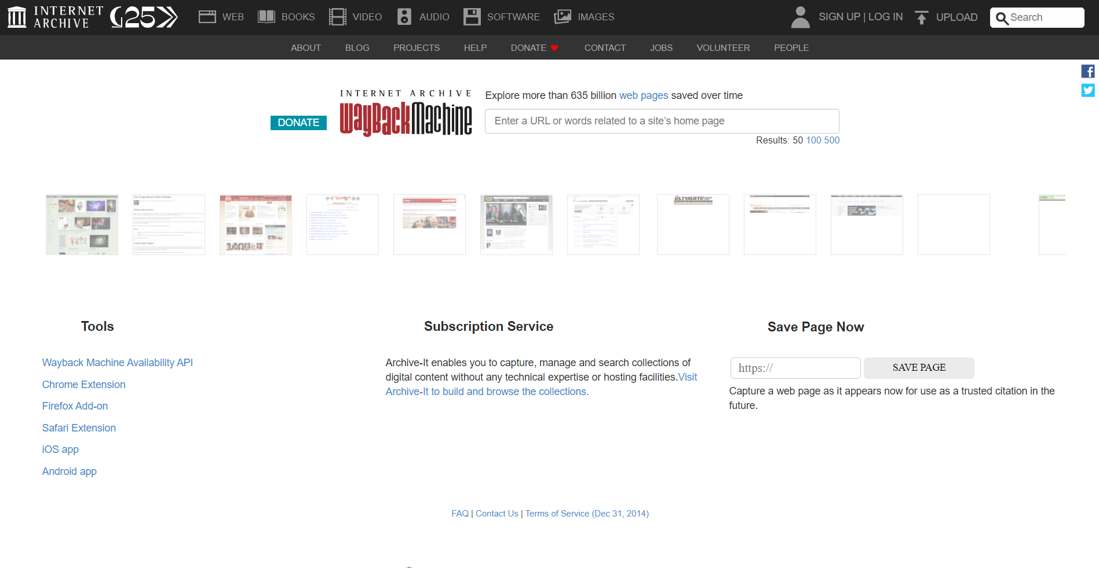
WAYBACK MACHINE / ARCHIVE.ORG

Slide 61
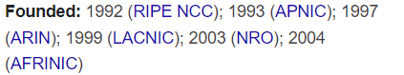
Internet registries
An Internet registry is primarily responsible for allocating and assigning IP numbers to devices, websites, information systems, autonomous systems and more. ... Each region maintains its regional Internet registry (RIR) that allocates IP numbers and autonomous systems within its region or to the local Internet registry.

Slide 62
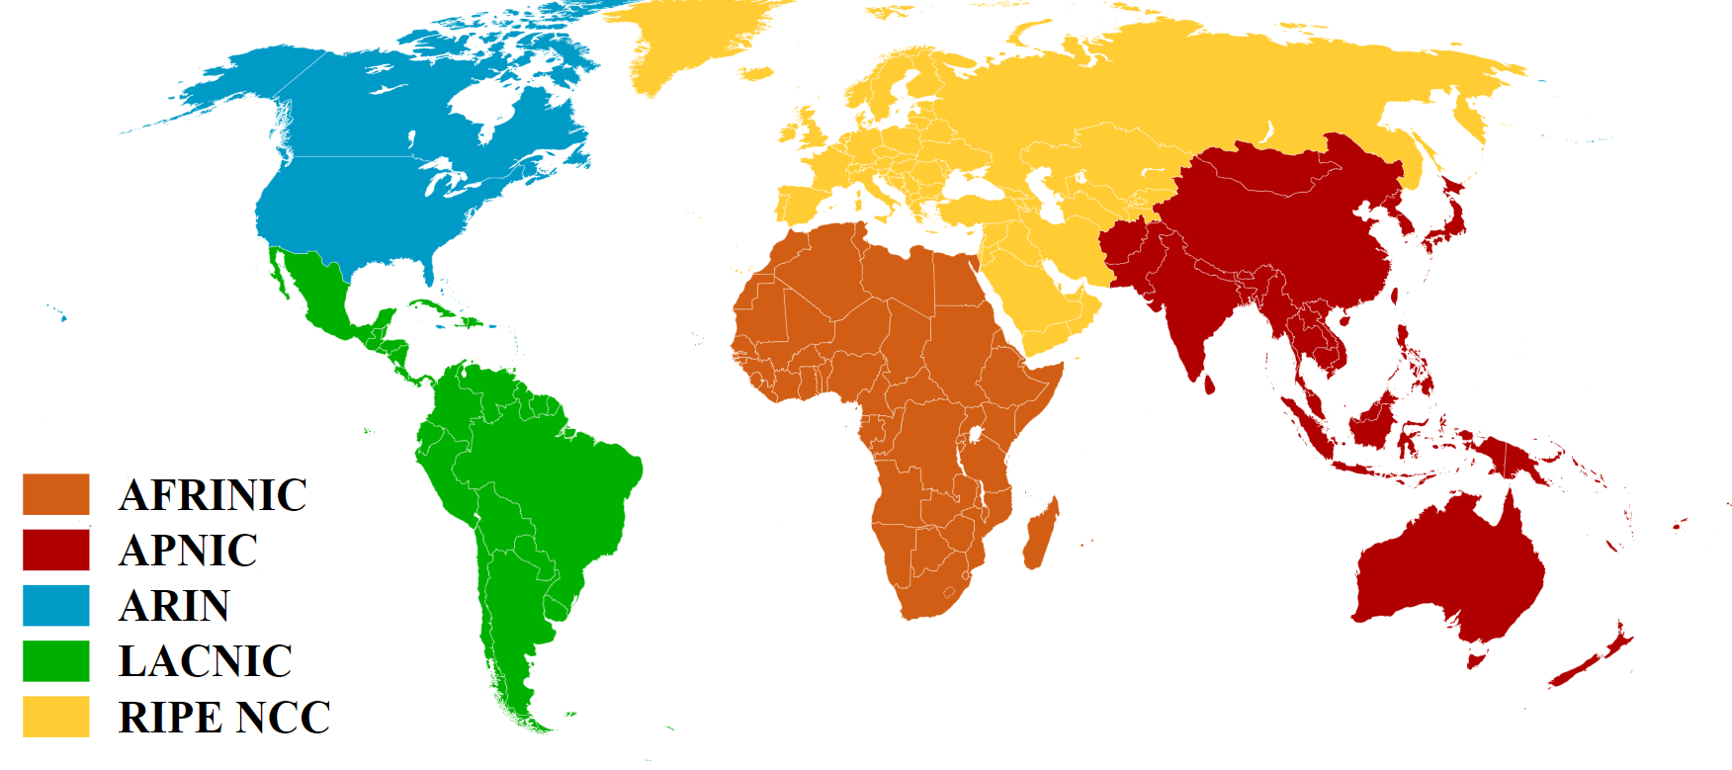
REGIONAL INTERNET REGISTERS

Slide 63
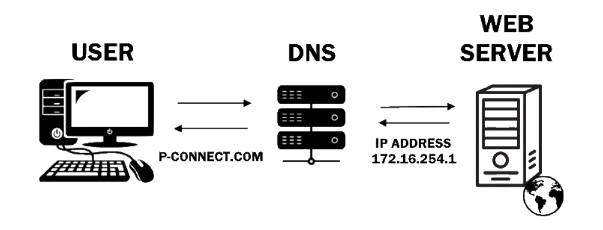
What is dns (Domain name Service)
A DNS is like a phone book for the internet. With a phone book, you can look up your friend’s name and find their phone number instead of having to remember the number yourself. Similarly, a DNS allows users to reference simple domain names like https://www.performanceconnectivity.com when looking for a particular website instead of difficult to remember IP Addresses.

Slide 64
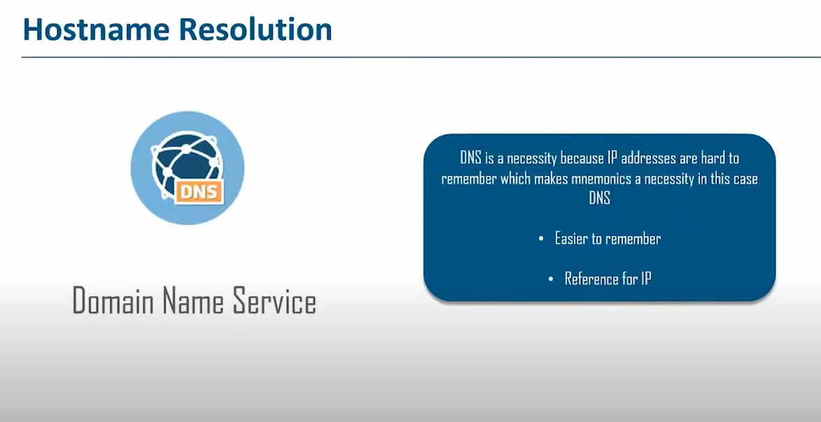
DNS

Slide 65
USING DNS TO GET INFORMATION

Slide 66
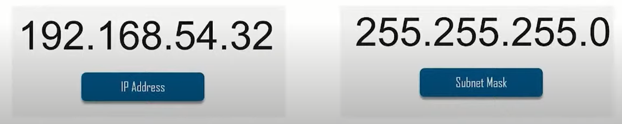
Finding network ranges

Slide 67
Tcp / ip

Slide 68
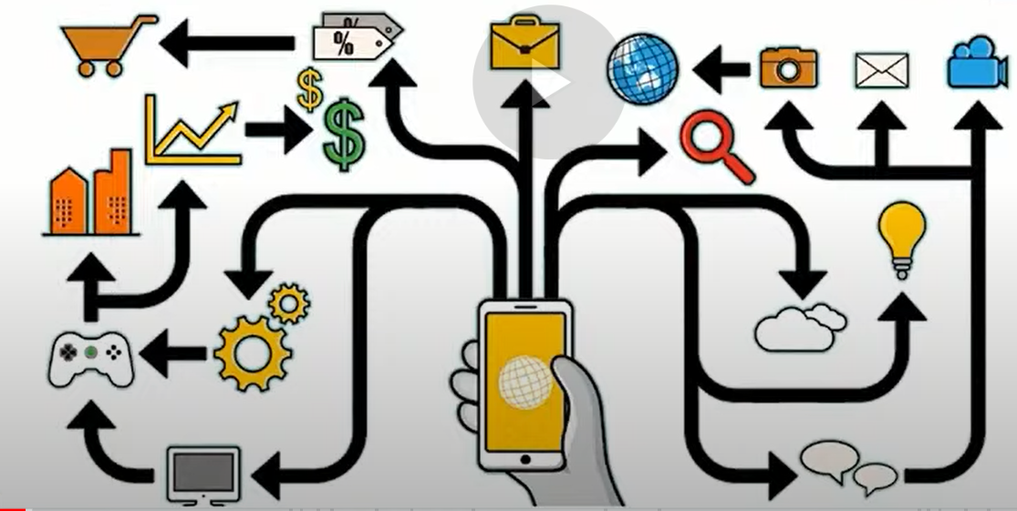
History of internet

Slide 69
What is TCP / IP / OSI MODEL
The Internet protocol suite, commonly known as TCP/IP, is the set of communications protocols used in the Internet and similar computer networks. The current foundational protocols in the suite are the Transmission Control Protocol and the Internet Protocol.

Slide 70
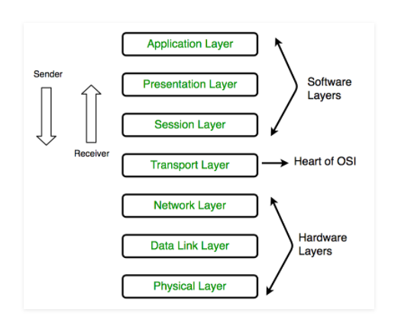
Osi and tcp /ip model
OSI MODEL

Slide 71
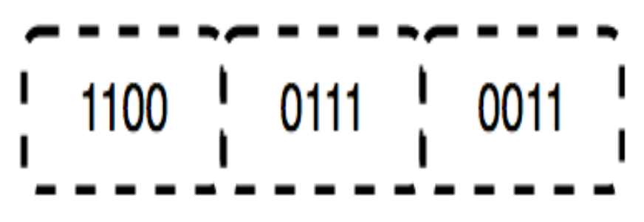
Physical Layer (Layer 1) :
The lowest layer of the OSI reference model is the physical layer. It is responsible for the actual physical connection between the devices. The physical layer contains information in the form of bits. It is responsible for transmitting individual bits from one node to the next. When receiving data, this layer will get the signal received and convert it into 0s and 1s and send them to the Data Link layer, which will put the frame back together.

Slide 72

2. Data Link Layer (DLL) (Layer 2) :
The data link layer is responsible for the node-to-node delivery of the message. The main function of this layer is to make sure data transfer is error-free from one node to another, over the physical layer. When a packet arrives in a network, it is the responsibility of DLL to transmit it to the Host using its MAC address. Data Link Layer is divided into two sublayers:
Logical Link Control (LLC)
Media Access Control (MAC)

Slide 73

3. Network Layer (Layer 3) :
The network layer works for the transmission of data from one host to the other located in different networks. It also takes care of packet routing i.e. selection of the shortest path to transmit the packet, from the number of routes available. The sender & receiver’s IP addresses are placed in the header by the network layer. The functions of the Network layer are :
Routing: The network layer protocols determine which route is suitable from source to destination. This function of the network layer is known as routing.
Logical Addressing: In order to identify each device on internetwork uniquely, the network layer defines an addressing scheme. The sender & receiver’s IP addresses are placed in the header by the network layer. Such an address distinguishes each device uniquely and universally.

Slide 74
Transport Layer (Layer 4) :
Transport layer receives the formatted data from the upper layers, performs Segmentation, and also implements Flow & Error control to ensure proper data transmission. It also adds Source and Destination port numbers in its header and forwards the segmented data to the Network Layer.
* Data in the Transport Layer is called as Segments. ** Transport layer is operated by the Operating System. It is a part of the OS and communicates with the Application Layer by making system calls. Transport Layer is called as Heart of OSI model.

Slide 75
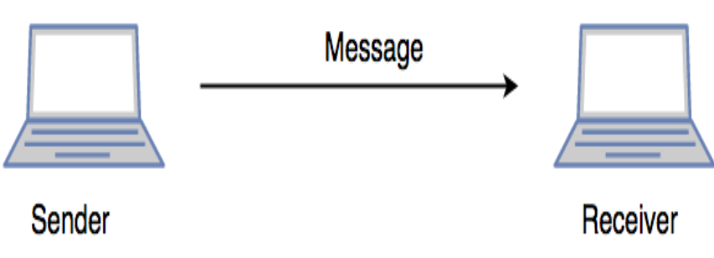
5. Session Layer (Layer 5) :
This layer is responsible for the establishment of connection, maintenance of sessions, authentication, and also ensures security. The functions of the session layer are :
Session establishment, maintenance, and termination: The layer allows the two processes to establish, use and terminate a connection.
Synchronization: This layer allows a process to add checkpoints which are considered synchronization points into the data. These synchronization points help to identify the error so that the data is re-synchronized properly, and ends of the messages are not cut prematurely and data loss is avoided.
Dialog Controller: The session layer allows two systems to start communication with each other in half-duplex or full-duplex.

Slide 76
6. Presentation Layer (Layer 6) :
The presentation layer is also called the Translation layer. The data from the application layer is extracted here and manipulated as per the required format to transmit over the network. The functions of the presentation layer are :
Translation: For example, ASCII to EBCDIC.
Encryption/ Decryption: Data encryption translates the data into another form or code. The encrypted data is known as the ciphertext and the decrypted data is known as plain text. A key value is used for encrypting as well as decrypting data.
Compression: Reduces the number of bits that need to be transmitted on the network.

Slide 77

7. Application Layer (Layer 7) :
At the very top of the OSI Reference Model stack of layers, we find the Application layer which is implemented by the network applications. These applications produce the data, which has to be transferred over the network. This layer also serves as a window for the application services to access the network and for displaying the received information to the user. Ex: Application – Browsers, Skype Messenger, etc. **Application Layer is also called Desktop Layer.

Slide 78
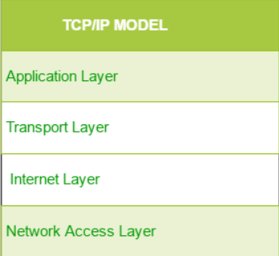
Osi and tcp /ip model
TCP/IP Model

Slide 79
1. Network Access Layer –
This layer corresponds to the combination of Data Link Layer and Physical Layer of the OSI model. It looks out for hardware addressing and the protocols present in this layer allows for the physical transmission of data. We just talked about ARP being a protocol of Internet layer, but there is a conflict about declaring it as a protocol of Internet Layer or Network access layer. It is described as residing in layer 3, being encapsulated by layer 2 protocols.

Slide 80
2. Internet Layer –
This layer parallels the functions of OSI’s Network layer. It defines the protocols which are responsible for logical transmission of data over the entire network. The main protocols residing at this layer are :
IP – stands for Internet Protocol and it is responsible for delivering packets from the source host to the destination host by looking at the IP addresses in the packet headers. IP has 2 versions: IPv4 and IPv6. IPv4 is the one that most of the websites are using currently. But IPv6 is growing as the number of IPv4 addresses are limited in number when compared to the number of users.
ICMP – stands for Internet Control Message Protocol. It is encapsulated within IP datagrams and is responsible for providing hosts with information about network problems.
ARP – stands for Address Resolution Protocol. Its job is to find the hardware address of a host from a known IP address. ARP has several types: Reverse ARP, Proxy ARP, Gratuitous ARP and Inverse ARP.

Slide 81
3. Host-to-Host Layer –
This layer is analogous to the transport layer of the OSI model. It is responsible for end-to-end communication and error-free delivery of data. It shields the upper-layer applications from the complexities of data. The two main protocols present in this layer are :
Transmission Control Protocol (TCP)
User Datagram Protocol (UDP) –

Slide 82
4. Application Layer –
This layer performs the functions of top three layers of the OSI model: Application, Presentation and Session Layer. It is responsible for node-to-node communication and controls user-interface specifications. Some of the protocols present in this layer are: HTTP, HTTPS, FTP, TFTP, Telnet, SSH, SMTP, SNMP, NTP, DNS, DHCP, NFS, X Window, LPD. Have a look at Protocols in application layer for some information about these protocols. Protocols other than those present in the linked article are :
HTTP and HTTPS
SSH
NTP

Slide 83
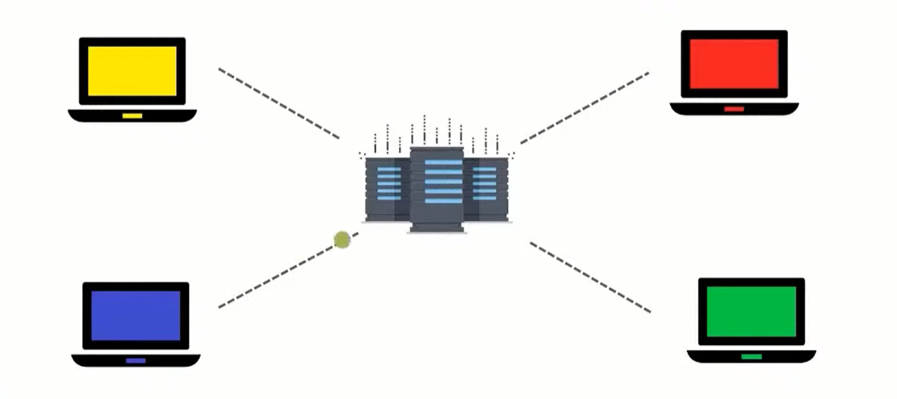
Addressing - Unicast

Slide 84
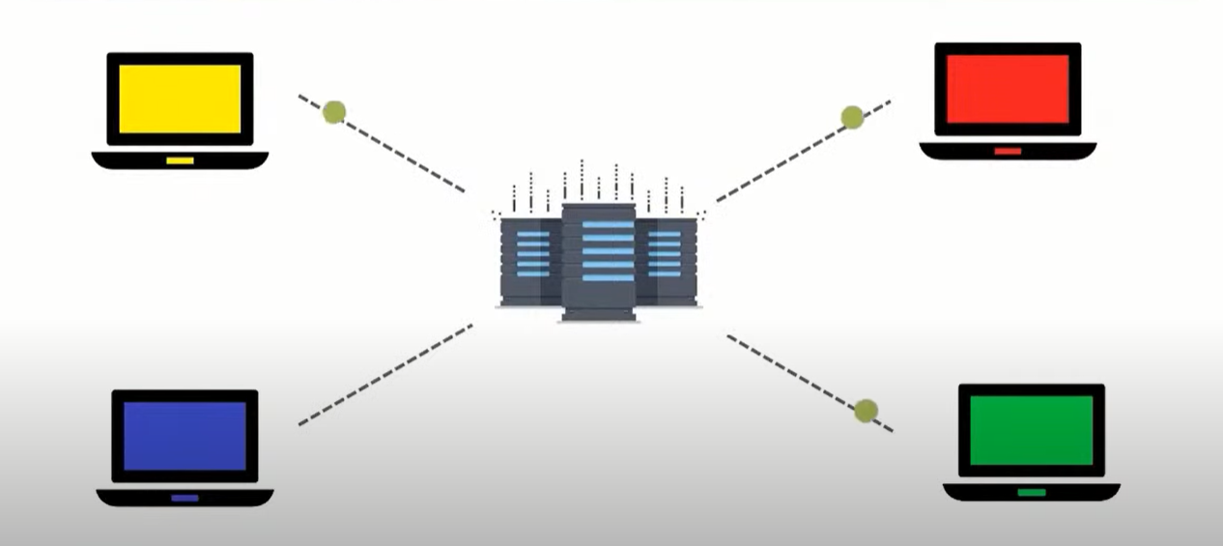
Addressing - broadcast

Slide 85
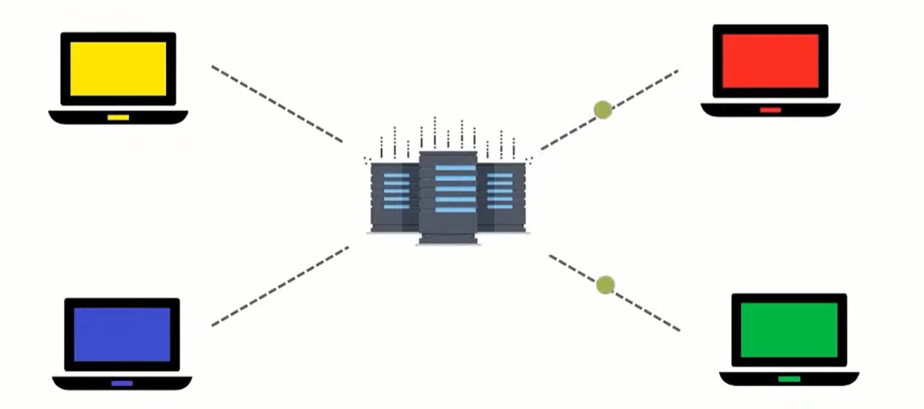
Addressing - multicast

Slide 86

What is wireshark

Slide 87
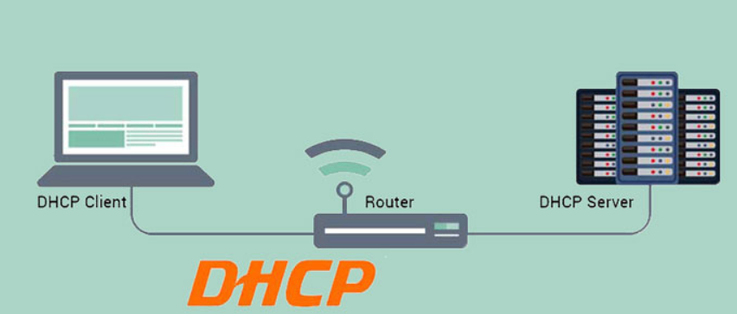
What is dhcp
Dynamic Host Configuration Protocol(DHCP) is an application layer protocol which is used to provide:
Subnet Mask (Option 1 – e.g., 255.255.255.0)
Router Address (Option 3 – e.g., 192.168.1.1)
DNS Address (Option 6 – e.g., 8.8.8.8)
Vendor Class Identifier (Option 43 – e.g., ‘unifi’ = 192.168.1.9 ##where unifi = controller)

Slide 88
DHCP is based on a client-server model and based on discovery, offer, request, and ACK.
In DHCP Client And Server Excahange Mainly 4 DHCP Messages in order to make a connection, also called DORA.
But there are 8 DHCP messages in the process:
DHCP discover message
DHCP offer message
DHCP request message
DHCP acknowledgement message
DHCP negative acknowledgement message
DHCP decline
DHCP release
DHCP inform

Slide 89
Why use DHCP
A DHCP server is a network server that automatically assigns IP addresses, default gateways and other network parameters to client devices. It is based on the Dynamic Host Configuration Protocol (DHCP) to respond to broadcast queries by clients.
To connect to an IP network, a host needs an IP address. To communicate with other networks it needs to know the default gateway address and the subnet mask for the local network. To perform name resolution, a host needs to know the name of a DNS server in advance. DHCP provides all of this information dynamically. For IP based networks, there are three ways to get an IP address: configure it manually, retreive it via BootP, or retreive it and other values via DHCP.

Slide 90
Cyber security components

Slide 91
Agenda
Packet Structure.
Addressing.
Network Architecture.
Firewalls.

Slide 92

Network part – downloading a file

Slide 93
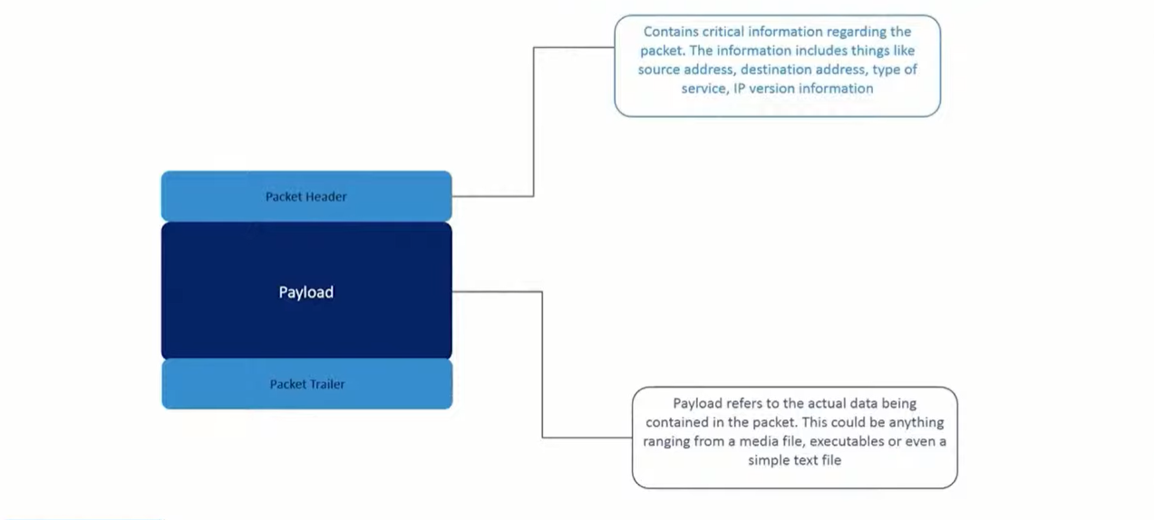
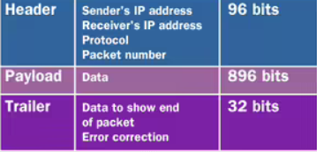
Packet of what

Slide 94
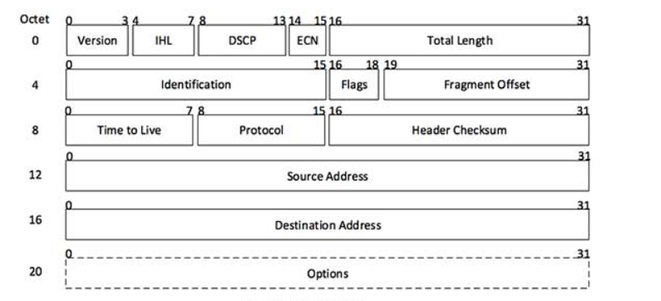
IPv4 packet

Slide 95

Visiting Google

Slide 96
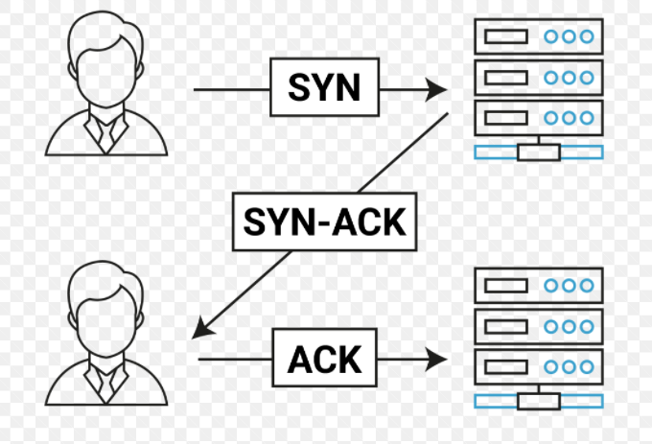
Tcp/ip – three way hand shake

Slide 97
Difference between ip and mac address
The main difference between MAC and IP address is that MAC Address is used to ensure the physical address of the computer. It uniquely identifies the devices on a network. While IP addresses are used to uniquely identifies the connection of the network with that device takes part in a network.

Slide 98
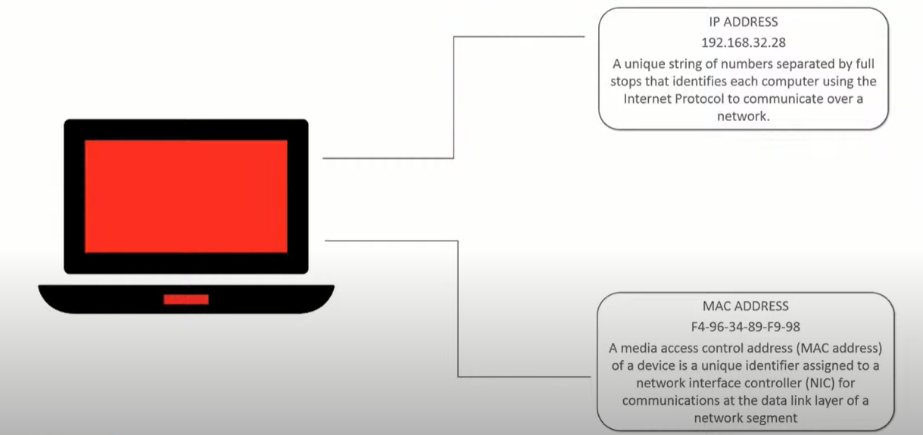
What’s my computer address

Slide 99
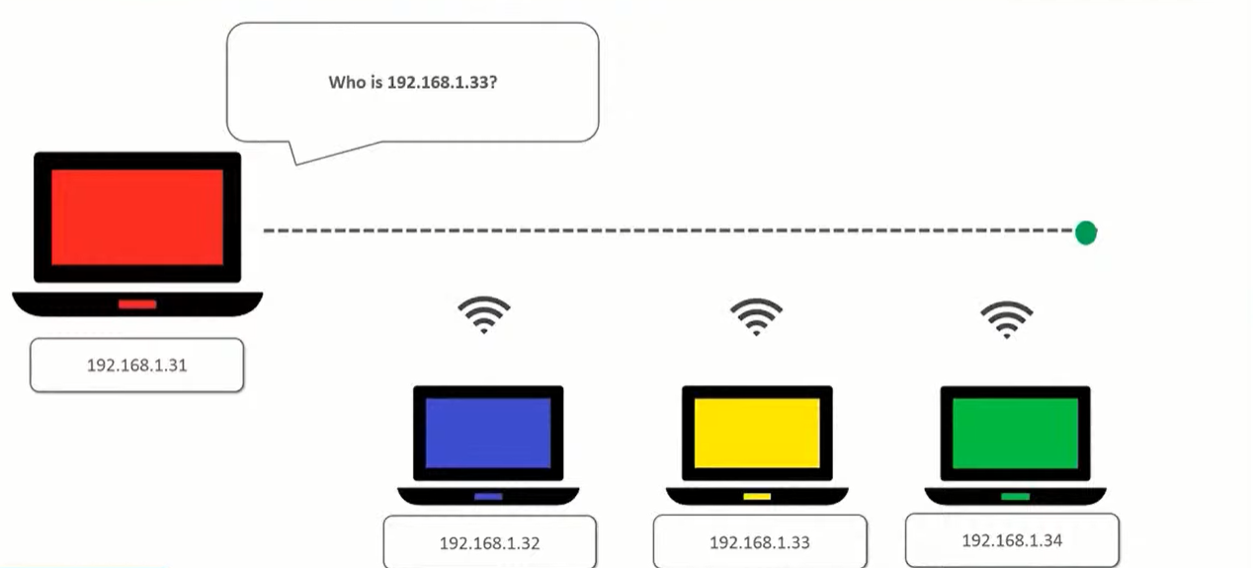
Address resolution protocol

Slide 100
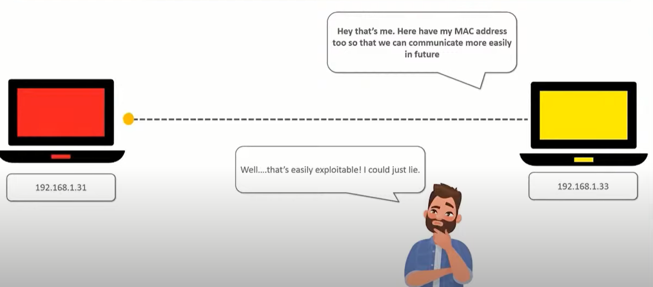
Address resolution protocol

Slide 101
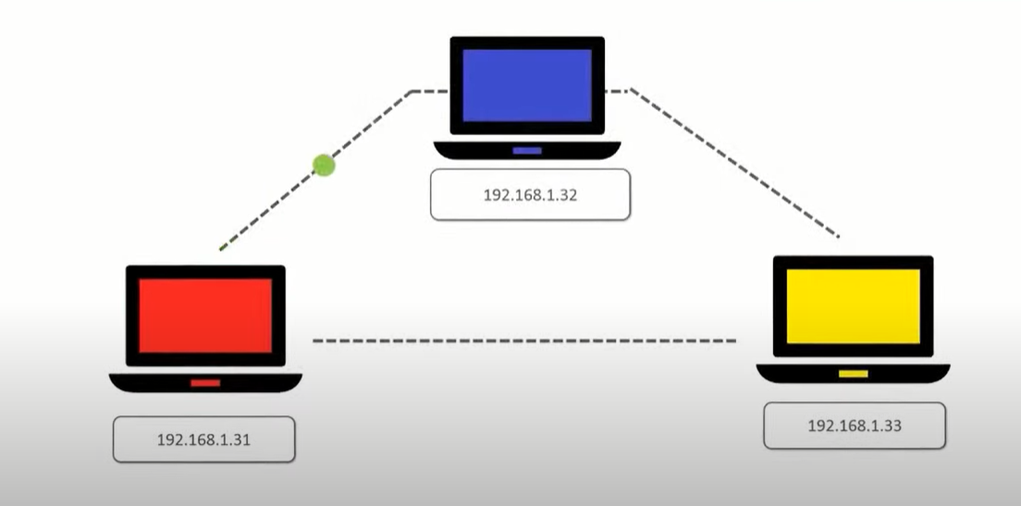
Liars….

Slide 102
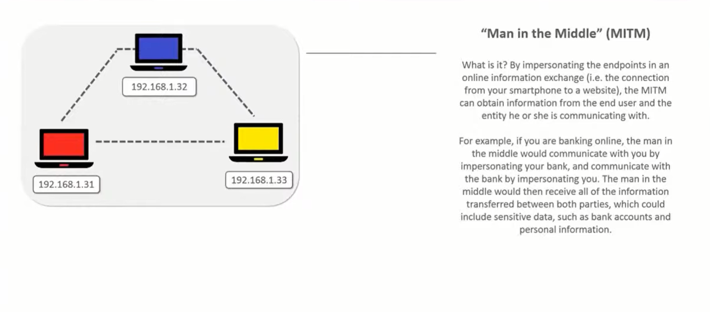
Man in the middle

Slide 103
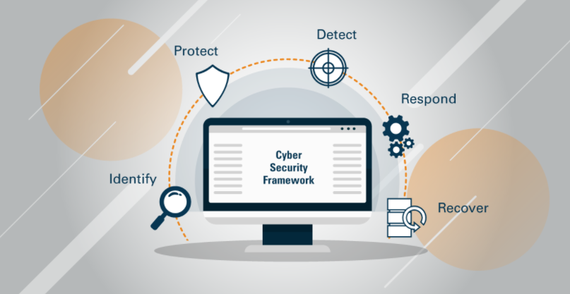
cyber Security frameworks

Slide 104
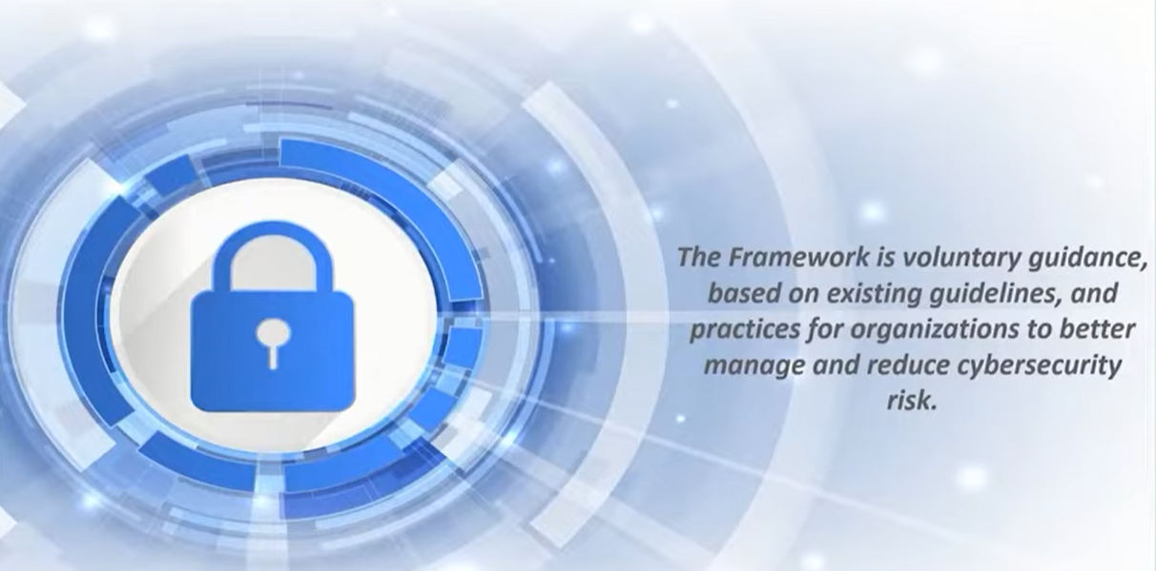
What is framework

Slide 105

Why cyber security frame work

Slide 106

Types of cyber security frameworks

Slide 107

objectives

Slide 108

Framework profile

Slide 109
Implement framework
Set Your target Goals
Create a Detailed profile
Assess Your Current Position.
Gap Analysis And Action Plan.
Implement Your Action Plan.

Slide 110
Fundamentals of networking

Slide 111
Introduction to kali Linux
Kali Linux is a Debian-derived Linux distribution designed for digital forensics and penetration testing. It is maintained and funded by Offensive Security.
Eg: Parrot Os, BackBox, Black Art etc…
Why Choose kali Linux When You have Other numerous Option.
It has More than 600 penetration testing tools.
Customizable.
Secure Platform.
Multi languages.
Cost Free..
Different Installation Option..

Slide 112

Introduction to kali Linux
Installing kali Linux..
Kali Bootable USB Drive.
Kali Linux using hardisk.
Dual Boot kali with Windows or mac
Using Virtualization software

Slide 113
NMAP

Slide 114
What is NMAP
Nmap is a network scanner created by Gordon Lyon.
Nmap is used to discover hosts and services on a computer network by sending packets and analyzing the responses.
Nmap provides a number of features for probing computer networks, including host discovery and service and operating system detection.

Slide 115
What is NMAP
Nmap is a network scanner created by Gordon Lyon.
Nmap is used to discover hosts and services on a computer network by sending packets and analyzing the responses.
Nmap provides a number of features for probing computer networks, including host discovery and service and operating system detection.

Slide 116
NSLOOK UP
nslookup is a network administration command-line tool for querying the Domain Name System to obtain the mapping between domain name and IP address, or other DNS records
nslookup is the name of a program that lets an Internet server administrator or any computer user enter a host name (for example, "whatis.com") and find out the corresponding IP address or domain name system (DNS) record.

Slide 117
Client URL (CURL)
cURL is a computer software project providing a library and command-line tool for transferring data using various network protocols. The name stands for "Client URL“
What is in a curl command?
cURL, which stands for client URL, is a command line tool that developers use to transfer data to and from a server. At the most fundamental, cURL lets you talk to a server by specifying the location (in the form of a URL) and the data you want to send.

Slide 118

Penetration testing

Slide 119

Penetration testing phases

Slide 120

Penetration testing types

Slide 121

Penetration testing types

Slide 122

Penetration testing tools

Slide 123
Cyber Security And Ethical hacking

Slide 124

Cyber Security And Ethical hacking
What is Cyber Security.
Computer security, cyber security, or information technology security is the protection of computer systems and networks from information disclosure, theft of or damage to their hardware, software, or electronic data, as well as from the disruption or misdirection of the services they provide.

Slide 125

Cyber Security and Ethical hacking
What is Ethical hacking
Ethical hacking involves an authorized attempt to gain unauthorized access to a computer system, application, or data. Carrying out an ethical hack involves duplicating strategies and actions of malicious attackers.

Slide 126

Kali Linux

Slide 127

Why Use kali Linux

Slide 128

Proxy chains
Proxy Chains are basically chain of proxy’s.
1. Where Do you use proxy.
Where You Want To Be Anonymous Yourself into wire or network

Slide 129
What does Proxy chains Do.
Proxy Chains is a tool that forces any TCP connection made by any given application to go through proxies like TOR or any other SOCKS4, SOCKS5 or HTTP proxies. ... Essentially, you can use Proxy Chains to run any program through a proxy server.

Slide 130

MACCHANGEr

Slide 131

Why Should mac be Unique

Slide 132

Introduction to cryptography

Slide 133

Introduction to cryptography

Slide 134

What is cryptography
Cryptography is a method of protecting information and communications through the use of codes, so that only those for whom the information is intended can read and process it.

Slide 135

What is cryptography

Slide 136

What is cryptography

Slide 137

What is cryptography

Slide 138

What is cryptography

Slide 139

What is cryptography

Slide 140

Classification of cryptography

Slide 141

Symmetric key cryptography

Slide 142

Transposition cipher

Slide 143


Substitution cipher
Hiding some data is known as encryption. When plain text is encrypted it becomes unreadable and is known as cipher text.
In a Substitution cipher, any character of plain text from the given fixed set of characters is substituted by some other character from the same set depending on a key.

Slide 144

Rot13

Slide 145



Stream Ciphers
A Symmetric Or Secret Key Encryption Algorithm that encrypts a single bit at a time. With Stream Cipher The Same Plaint Text Bit or Bytes Will Encrypt to a Different bit Or Byte Every time it is Encrypted

Slide 146

Block cipher

Slide 147

Public key cryptography
Asymmetric is a form of Cryptosystem in which encryption and decryption are performed using different keys-Public key (known to everyone) and Private key (Secret key). This is known as Public Key Encryption.

Slide 148
Hands On Encryption and decryption using openssl

Slide 149
phishing attack

Slide 150

What is phishing ATTACK
Phishing is a type of social engineering where an attacker sends a fraudulent message designed to trick a human victim into revealing sensitive information ...

Slide 151

What is phishing ATTACK
Phishing is a type of social engineering where an attacker sends a fraudulent message designed to trick a human victim into revealing sensitive information ...

Slide 152

How it works

Slide 153

How to use phishing

Slide 154
Hands on phishing attack

Slide 155
How to be safe from phishing attack

Slide 156
Hands on Key logger

Slide 157

Key logger is a malicious computer program that records everything you type on the keyboard and learns the keystroke pattern including words, characters, symbols and sends all the recorded details to the malicious hackers.

Slide 158


Slide 159
packet Sniffing and analysis

Slide 160
What is packet sniffing
When any data has to be transmitted over the computer network, it is broken down into smaller units at the sender’s node called data packets and reassembled at receiver’s node in original format. It is the smallest unit of communication over a computer network. It is also called a block, a segment, a datagram or a cell. The act of capturing data packet across the computer network is called packet sniffing. It is similar to as wire tapping to a telephone network. It is mostly used by crackers and hackers to collect information illegally about network. It is also used by ISPs, advertisers and governments.

Slide 161
SQL Injection
SQL injection is a code injection technique that might destroy your database.
SQL injection is one of the most common web hacking techniques.
SQL injection is the placement of malicious code in SQL statements, via web page input.
SQL injection usually occurs when you ask a user for input, like their username/userid, and instead of a name/id, the user gives you an SQL statement that you will unknowingly run on your database.

Slide 162

SQL Injection attack

Slide 163

SQL Injection attack – Non technical explanation

Slide 164

SQL Injection attack – Non technical explanation

Slide 165

SQL Injection attack – Non technical explanation

Slide 166

SQL Injection attack – Non technical explanation

Slide 167

Steganography
What is Steganography?
Steganography is the art and science of embedding secret messages in a cover message in such a way that no one, apart from the sender and intended recipient, suspects the existence of the message

Slide 168
How is Steganography different from Cryptography?
Cryptography changes the information to ciphertext which cannot be understood without a decryption key. So, if someone were to intercept this encrypted message, they could easily see that some form of encryption had been applied. On the other hand, steganography does not change the format of the information but it conceals the existence of the message.
So, in other words, steganography is more discreet than cryptography when we want to send confidential information. The downside being, the hidden message is easier to extract if the presence of secret is discovered.

Slide 169
Steganography Techniques
Text Steganography
Image Steganography
Video Steganography
Audio Steganography
Network Steganography

Slide 170
Concept of LSB based data embedding:
LSB stands for Least Significant Bit. The idea behind LSB embedding is that if we change the last bit value of a pixel, there won’t be much visible change in the color. For example, 0 is black. Changing the value to 1 won’t make much of a difference since it is still black, just a lighter shade.

Slide 171
What is dos /ddos attack
A distributed denial-of-service (DDoS) attack is a malicious attempt to disrupt the normal traffic of a targeted server, service or network by overwhelming the target or its surrounding infrastructure with a flood of Internet traffic.
DDoS attacks achieve effectiveness by utilizing multiple compromised computer systems as sources of attack traffic. Exploited machines can include computers and other networked resources such as IOT Devices.

Slide 172

What is dos /ddos attack
From a high level, a DDoS attack is like an unexpected traffic jam clogging up the highway, preventing regular traffic from arriving at its destination.

Slide 173
How does a DDoS attack work?
DDoS attacks are carried out with networks of Internet-connected machines.
These networks consist of computers and other devices (such as IoT devices)which have been infected with malware, allowing them to be controlled remotely by an attacker. These individual devices are referred to as bots (or zombies), and a group of bots is called a botnet.
Once a botnet has been established, the attacker is able to direct an attack by sending remote instructions to each bot.

Slide 174
How does a DDoS attack work?
When a victim’s server or network is targeted by the botnet, each bot sends requests to the target’s IP address, potentially causing the server or network to become overwhelmed, resulting in a denial-of-service to normal traffic.
Because each bot is a legitimate Internet device, separating the attack traffic from normal traffic can be difficult.

Slide 175
How to identify a DDoS attack
The most obvious symptom of a DDoS attack is a site or service suddenly becoming slow or unavailable.
Suspicious amounts of traffic originating from a single IP address or IP range
A flood of traffic from users who share a single behavioral profile, such as device type, geolocation, or web browser version
An unexplained surge in requests to a single page or endpoint.

Slide 176
What are some common types of Ddos attacks?
Different types of DDoS attacks target varying components of a network connection. In order to understand how different DDoS attacks work, it is necessary to know how a network connection is made.
A network connection on the Internet is composed of many different components or “layers”. Like building a house from the ground up, each layer in the model has a different purpose.
The OSI model, shown below, is a conceptual framework used to describe network connectivity in 7 distinct layers.

Slide 177


Slide 178

While nearly all DDoS attacks involve overwhelming a target device or network with traffic, attacks can be divided into three categories.
Application layer attacks
The goal of the attack:
Sometimes referred to as a layer 7 DDoS attack (in reference to the 7th layer of the OSI model), the goal of these attacks is to exhaust the target’s resources to create a denial-of-service.

Slide 179
HTTP flood
This attack is similar to pressing refresh in a web browser over and over on many different computers at once – large numbers of HTTP requests flood the server, resulting in denial-of-service.

Slide 180
Protocol attacks
The goal of the attack:
Protocol attacks, also known as a state-exhaustion attacks, cause a service disruption by over-consuming server resources and/or the resources of network equipment like firewalls and load balancers.
Protocol attacks utilize weaknesses in layer 3 and layer 4 of the protocol stack to render the target inaccessible.

Slide 181

Protocol attacks

Slide 182
Volumetric attacks
The goal of the attack:
This category of attacks attempts to create congestion by consuming all available bandwidth between the target and the larger Internet. Large amounts of data are sent to a target by using a form of amplification or another means of creating massive traffic, such as requests from a botnet.

Slide 183

Volumetric attacks

Slide 184
Demonstration ON DOS ATTACK

Slide 185

Popular Linux Distributions

